Slide 1
Operational Analysis
Juan Manuel Gonzalez

Slide 2
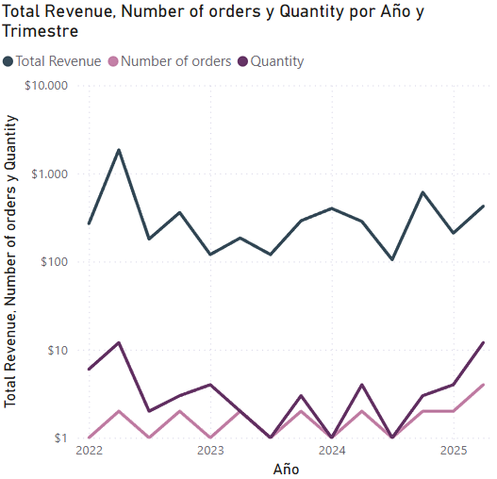
Revenue Fluctuates Despite Stable Order Volume from 2022 to 2025
In 2025, Quantity and Number of Orders increase sharply, yet Total Revenue grows moderately, suggesting a lower average revenue per order
Investigate if recent discounts, bundling strategies, or low-margin products are driving order volume but diluting profitability.

Slide 3
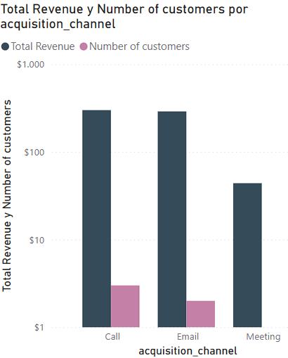
Calls Drive the Highest Revenue and Customer Acquisition Efficiency in 2025
In 2025, Calls and Emails generate similar high revenue, but Calls convert significantly more customers—indicating a higher acquisition efficiency.
Consider investing more in Call-based acquisition, as it yields strong revenue with a broader customer base compared to Email and Meetings.

Slide 4
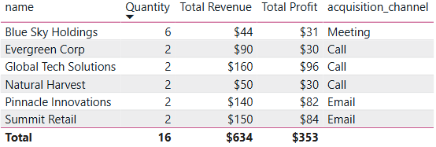
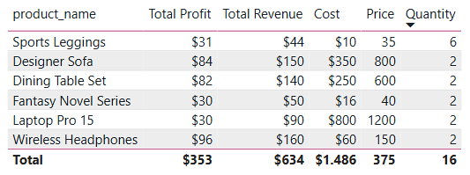
Profit Concentrated in Fewer Sales, While Meetings Underperform in ROI
In 2025, Wireless Headphones generate the highest profit ($96) despite having a mid-range price ($150) and low quantity sold (2 units), while Meeting-acquired clients contribute the lowest revenue and profit.
Focus on promoting high-margin products like Wireless Headphones and re-evaluate the Meeting acquisition channel, which yields poor ROI despite a higher number of units sold (6).

